Slide 1

Library Management System
Charlie Kinnett

Slide 2
Introduction
Library management faces challenges in organizing, tracking, and enhancing user experience due to outdated manual processes. The proposed Library Management System aims to address these challenges by introducing an automated and efficient system for managing library resources, streamlining operations, and improving accessibility for users.

Slide 3
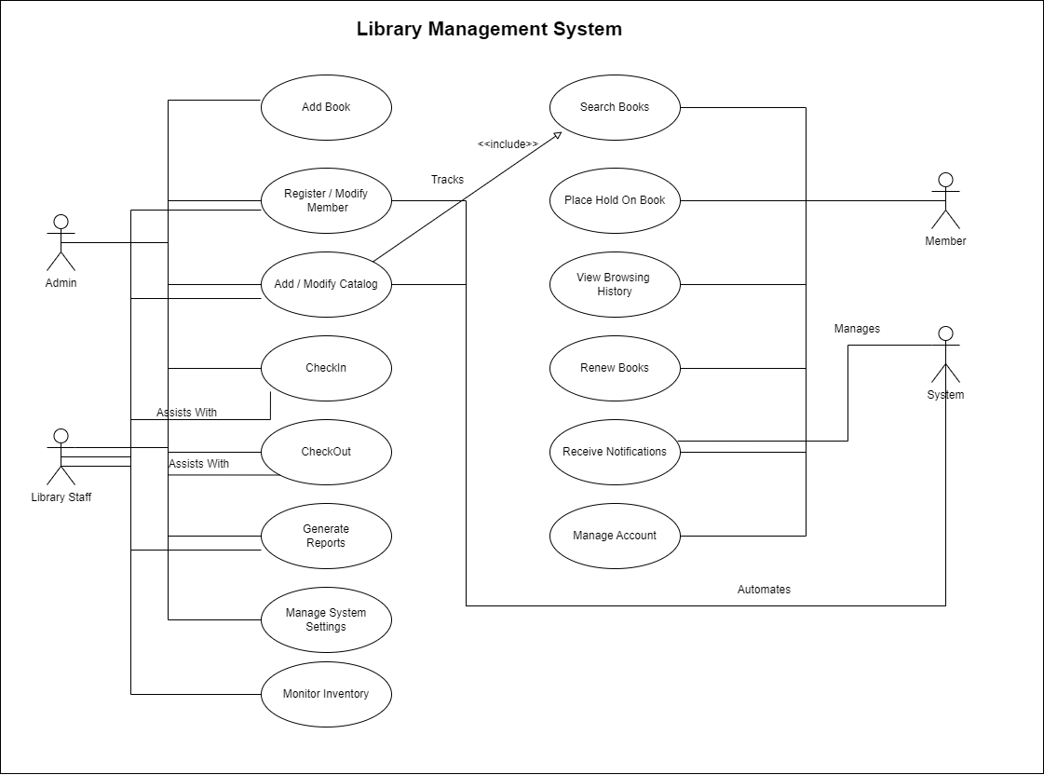
Use Case Diagram

Slide 4
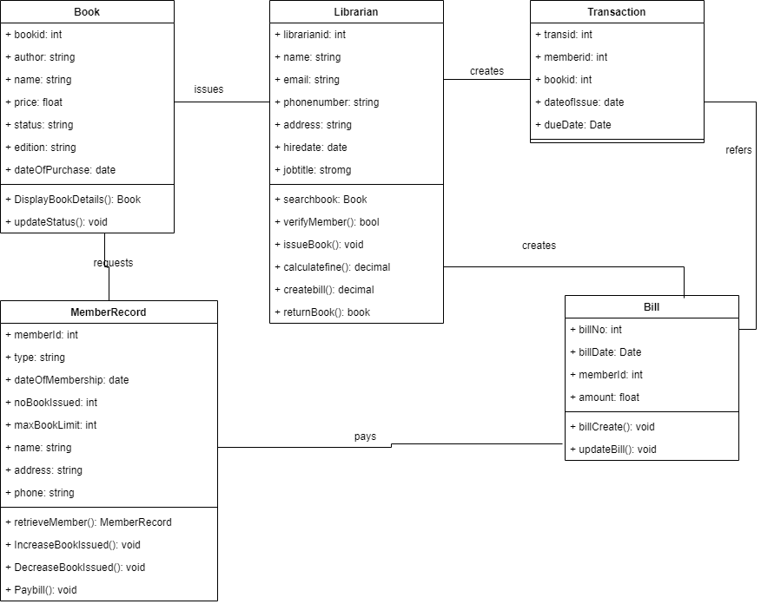
Class Diagram

Slide 5
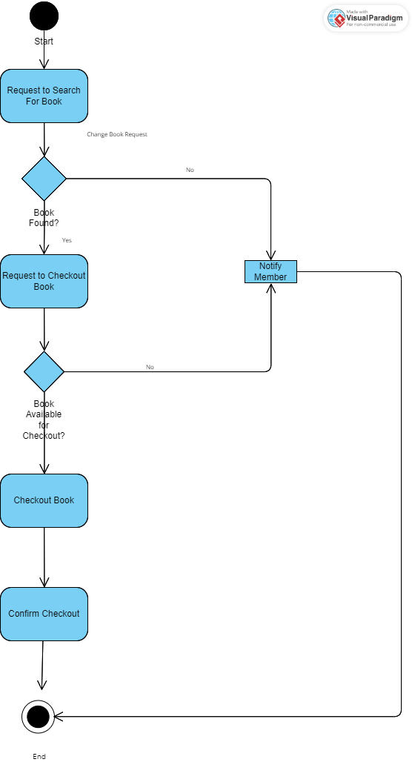
Activity Diagram

Slide 6
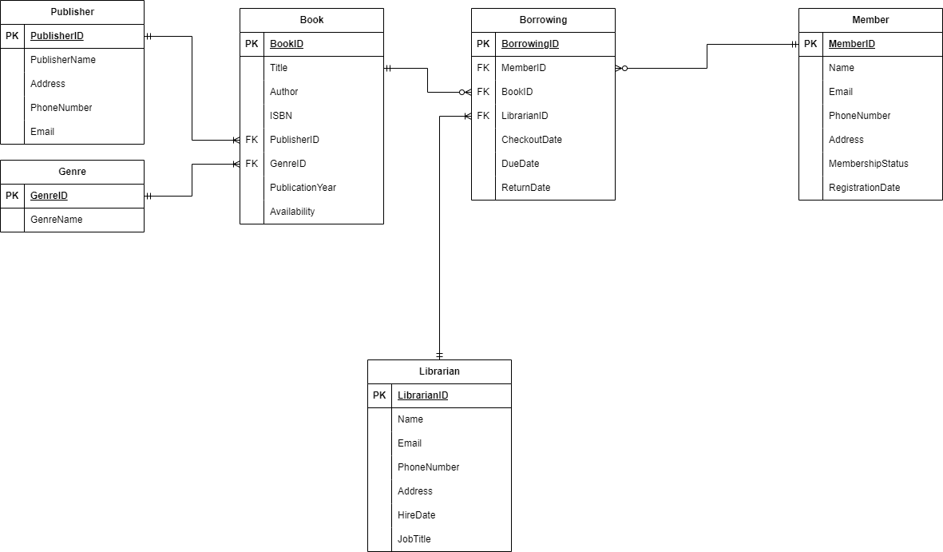
Database Implementation

